Slide 1
DAMG6210 DATABASE MANAGEMENT AND DATABASE DESIGN
CUSTOMER COMPLAINTS MANAGEMENT SYSTEM
TEAM 7
SHRIYA DIKSHIT - 002921535
SAI SUPRIYA KOMARRAJU - 002960655
KAVYASHREE UPENDRA - 002921251
VRUSHANK HIREMATH - 002926888
SINDHU SRINIVAS PRASAD - 00292301
SHARAN BALASUBRAMANIYAN - 002920078

Slide 2

CONCEPTS
BUSINESS IMPLEMENTATIONS
ERD
PROBLEM STATEMENT
REPORTS

Slide 3
BUSINESS IMPLEMENTATIONS
Maintaining Customer Complaints
Case Handling by Employee
Part Replacement
Case Resolution
Customer Feedback & Customer Retention
Warranty Subscription
Service Fee

Slide 4
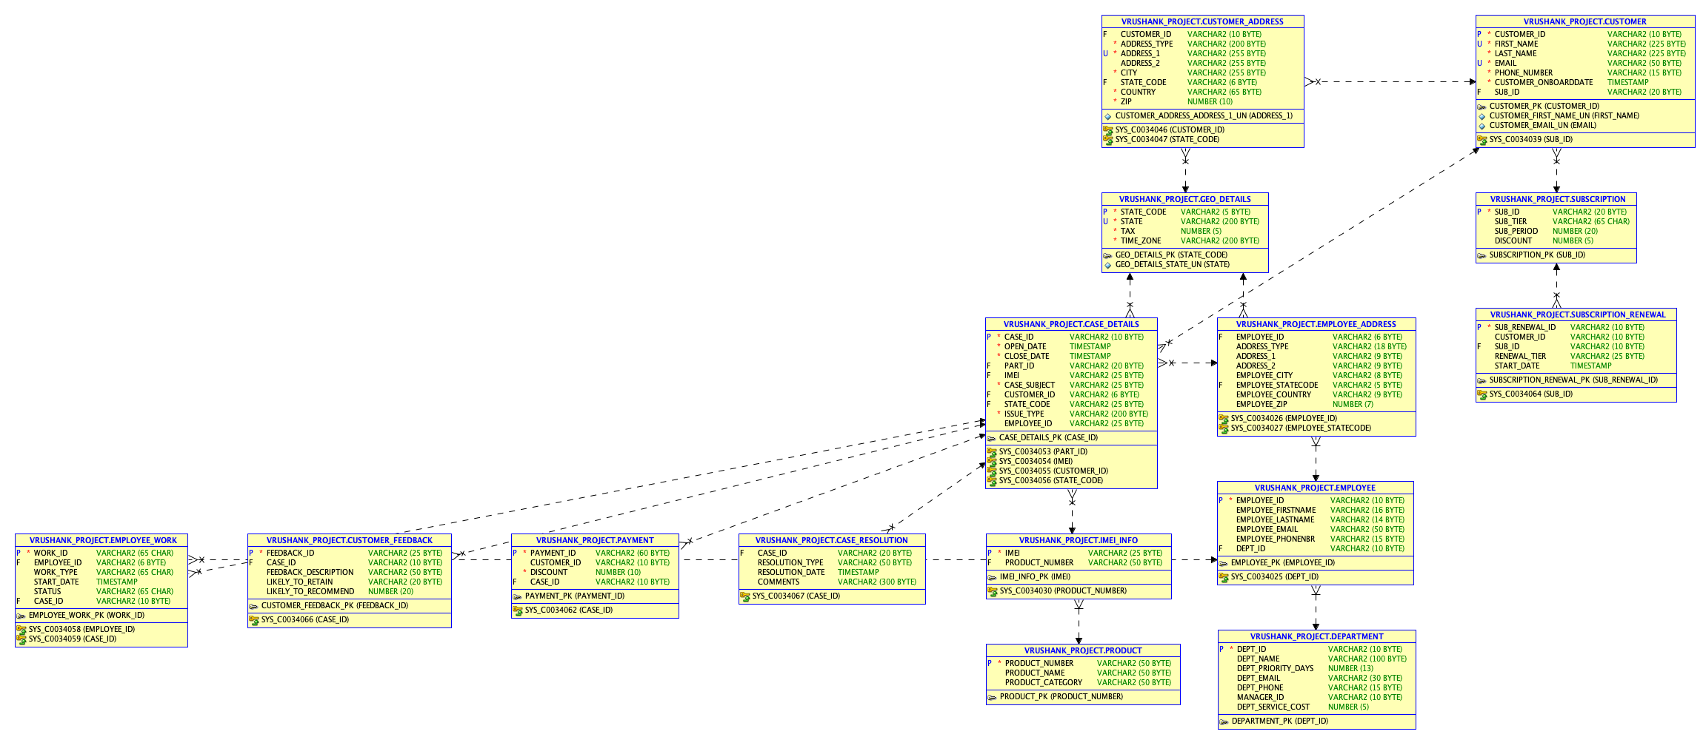
ERD

Slide 5
PROBLEM STATEMENT
The purpose of this database is to maintain customer complaints and hold the issues about products, accounts, payments and other services for a particular warranty period.
Through this customer retention can be achieved by resolving the case within the stipulated time and helping them track the status of their case.
Cost is calculated based on warranty details recorded in the customer data created by customer care
If the replacements/fixes are done within estimated time of resolution, then there is a high chance of customer retention
Users should be able to see where exactly their cases are stuck (which team).
If the replacements/fixes are done within estimated time of resolution, then there is a high chance of customer retention
As a result, client happiness determines the company's growth or decline, and the company can only grow if we work towards retaining and extracting more value from them.

Slide 6

REPORTS

